Slide 1

Designing websites
Lesson 2: Images and lists

Slide 2
Objectives
In this lesson, you will learn:
how to embed images on a web page
how to position elements on a web page
how to add margins around elements to improve the layout
how to create lists on a web page.

Slide 3
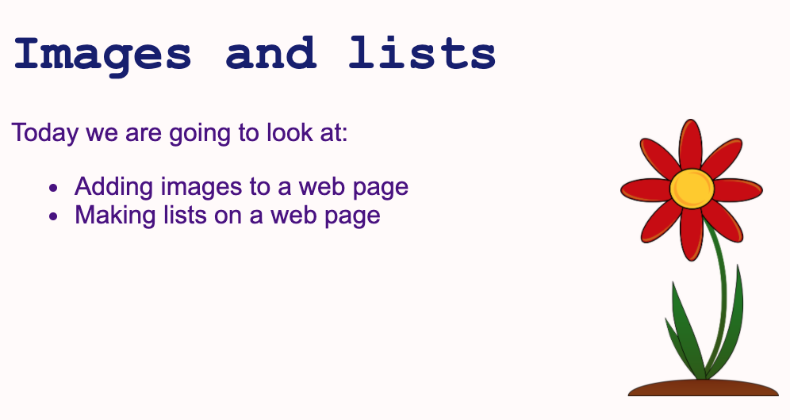

Slide 4
Embedding an image
It is very important that any images you wish to use on your web pages are saved to the same folder as the HTML and CSS files for that web page.
The <img> tag is used to embed an image in an HTML page.
There are two attributes that must be included inside the tag:
src: the link to the source image. Usually, this is the image's filename and extension.
alt: alternative text that describes the image, to be used if the image cannot be displayed. It is also used by screen readers.
It is also advisable to specify the width and the height of the image.

Slide 5
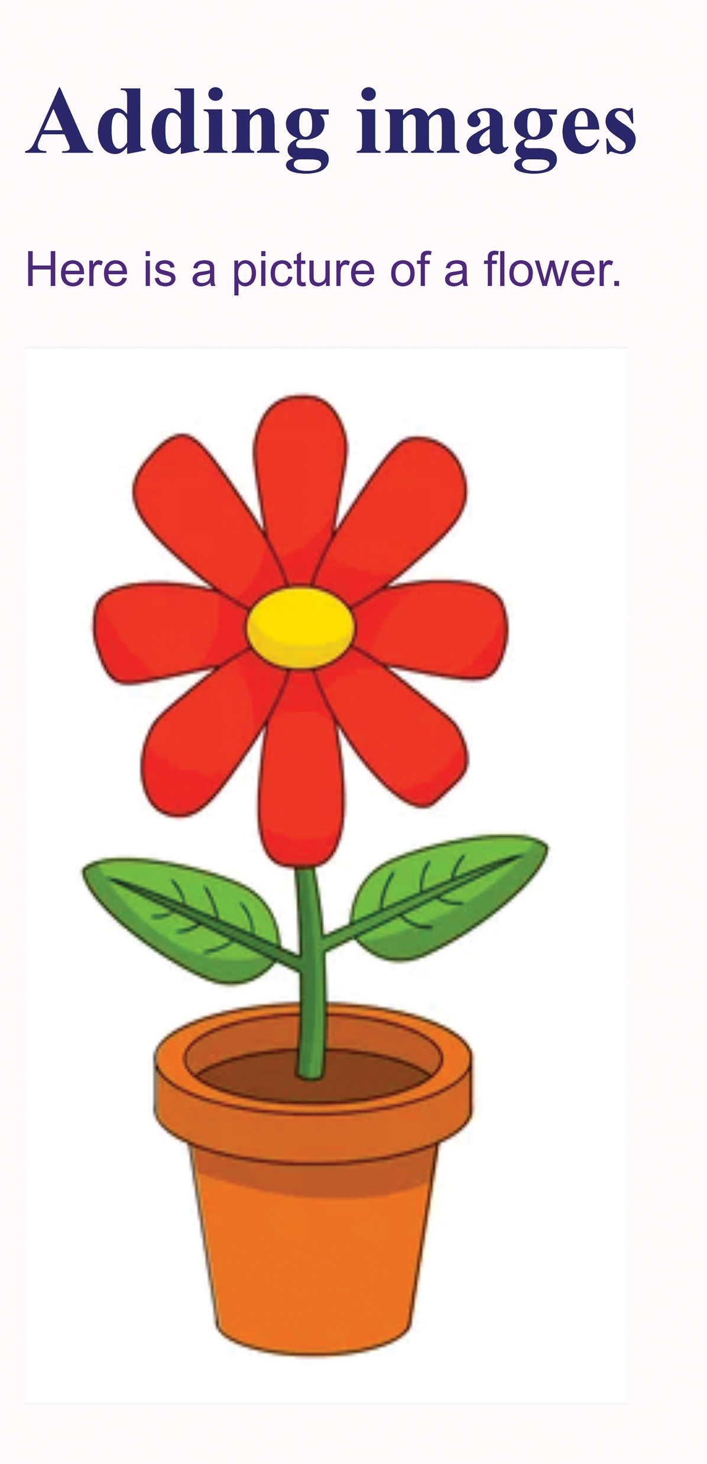
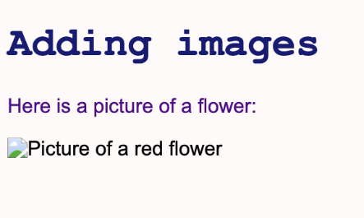
Displaying an image
The following code has been used to add a picture of a red flower to a web page:
If you add code to an HTML file to embed an image but the image does not display correctly, check that you have saved the image to the correct folder and that the filename and extension of the image are exactly the same as the code in the HTML document.
The browser could not locate the image because it was not stored in the correct folder. An icon and text are shown instead.
Watch Video 2.1
The web page has displayed correctly.

Slide 6

Activity 2.1: Embedding an image

Slide 7
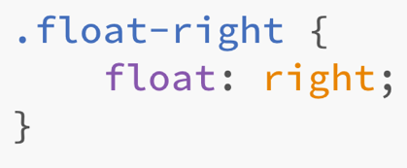
Using float to position an element
The CSS float property is used to position and format content.
It can be used to position an image alongside text.
Creating a class called float-right means that this styling can be applied to any HTML element to position it to the right of other elements:
It is also possible to float an element to the left of the screen or to the centre of the screen using the values left and center.
Note that the American spelling of ‘center’ is required.

Slide 8
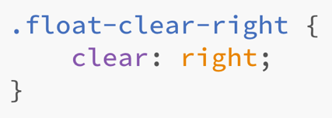
Using clear to prevent floating
The CSS clear property is used to prevent other elements from floating to the left or right of a specific paragraph element.
Using the value right will stop elements from floating on the right-hand side.
Using the value left will stop elements from floating on the left-hand side.
Using the value both will stop elements from floating on both the right- and left-hand sides.
The clear property is commonly used after the float property has been used, to return the layout to normal. The value used for the clear property should be the same as that used for the float property.
Watch Video 2.2

Slide 9
Activity 2.2: Floating an image

Slide 10
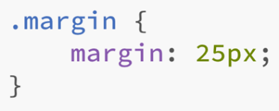
Using margin to add space around elements
The CSS margin property is used to create space around elements.
If you want to add the same size margin to all sides, use margin and one value. For example:
Use margin-top, margin-right, margin-bottom and margin-left to add a specific margin to a specific side.
Watch Video 2.3

Slide 11
Activity 2.3: Adding a margin

Slide 12
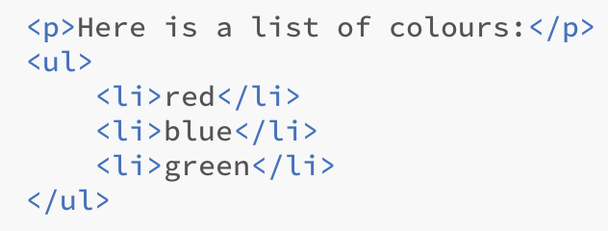
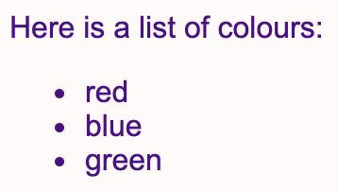
Unordered lists
Lists are used to present information in an ordered way.
Unordered lists use bullet points to mark each item. They are used when the order of the items is not important.
The <ul> tag is used to define an unordered list and each item in the list is preceded by the <li> tag.
For example:

Slide 13
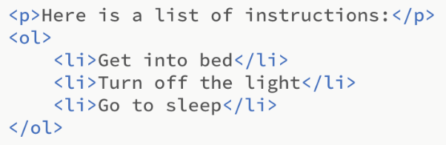
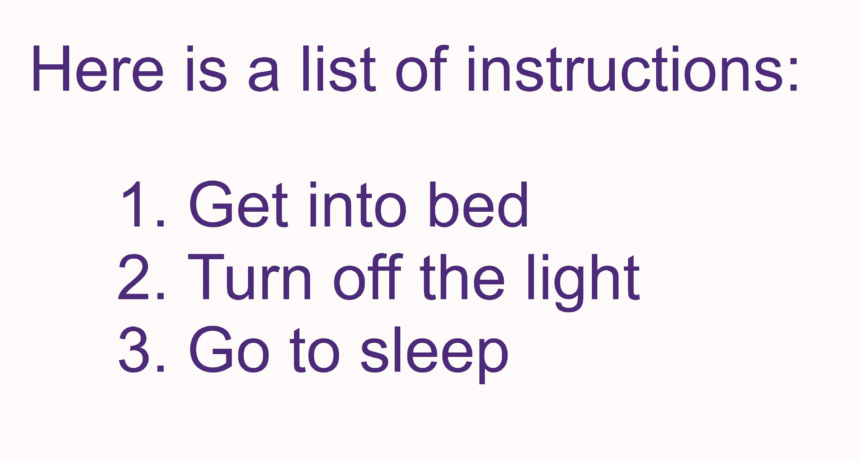
Ordered lists
In an ordered list, each item is marked by a number. They are used when the items need to be presented in a particular order.
The <ol> tag is used to define an ordered list and each item in the list is preceded by the <li> tag.
For example:
Watch Video 2.4

Slide 14
Activity 2.4: Creating lists

Slide 15
Quiz 2

